Slide 1
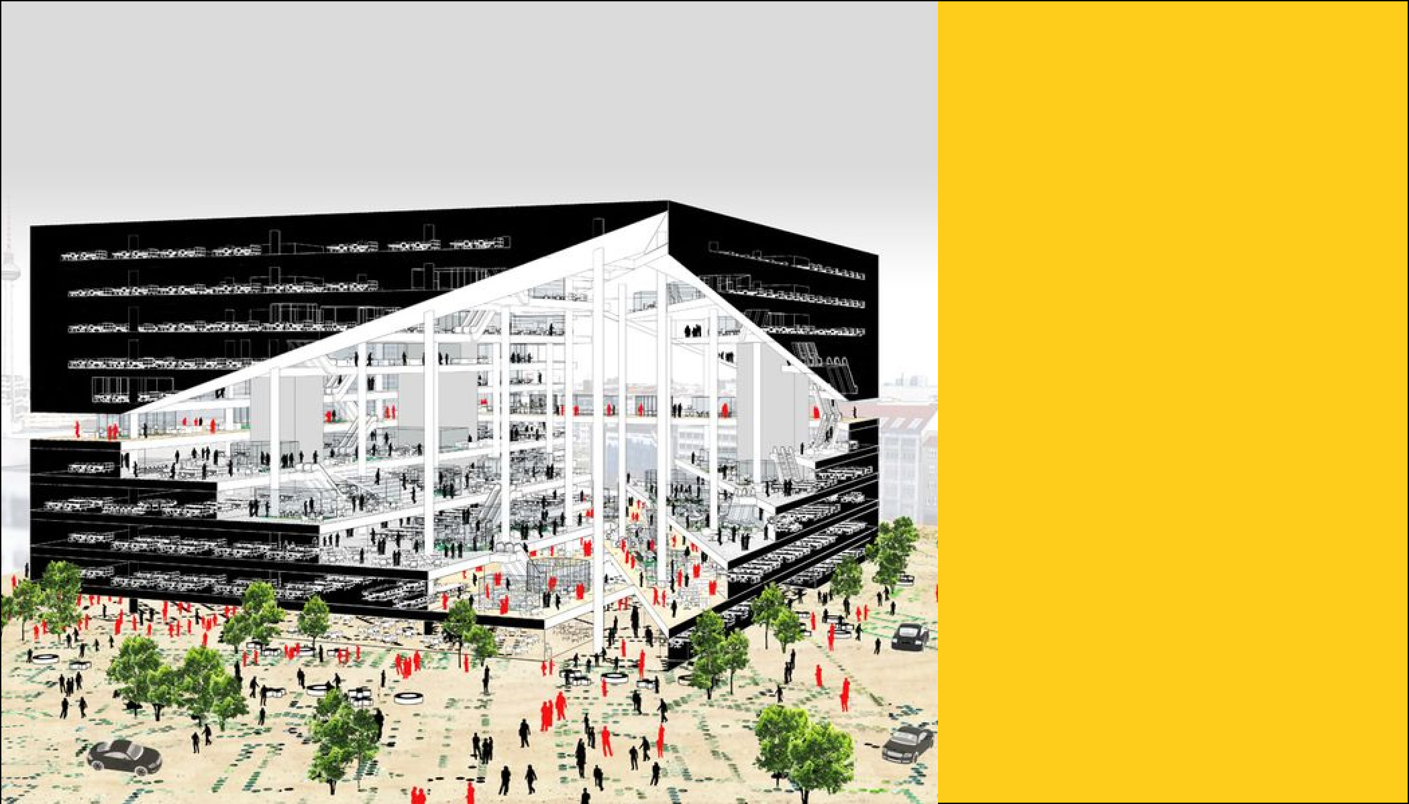
Between Space & Use
Karen Zellner
DAT-NYC-41
Notes:
Optimization of Architecture: An exploration into ways that machine learning and data science can influence architecture planning on a campus scale.

Slide 2
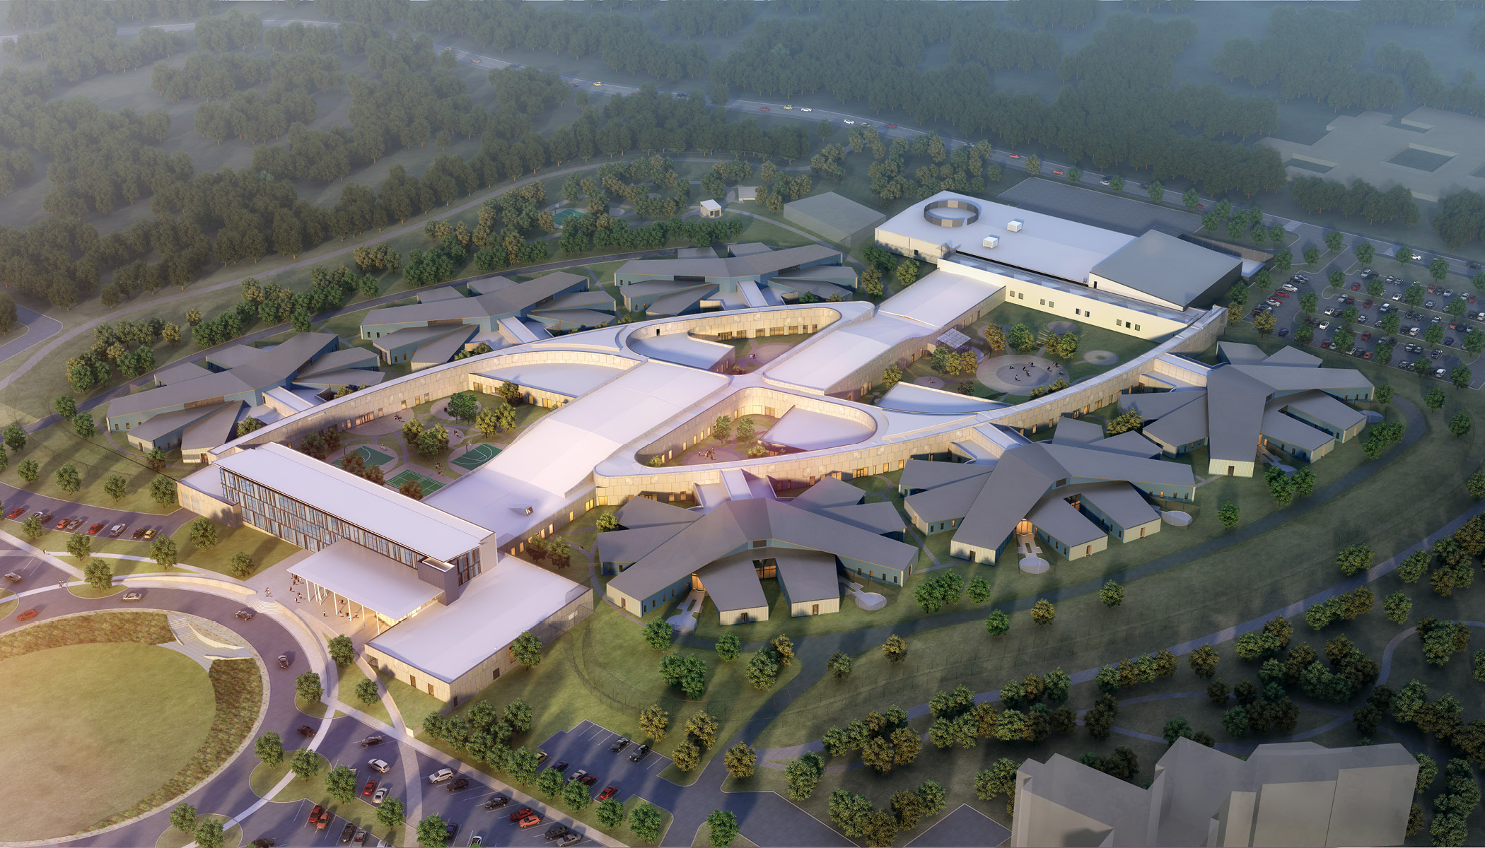
BACKGROUND
Notes:
Challenges faced when applying data science to design
– Classifier model isn’t very applicable to design as architecture is more subjective
- However using optimization is well suited as it can offer immediate efficiencies that would otherwise take a long time to discover

Slide 3

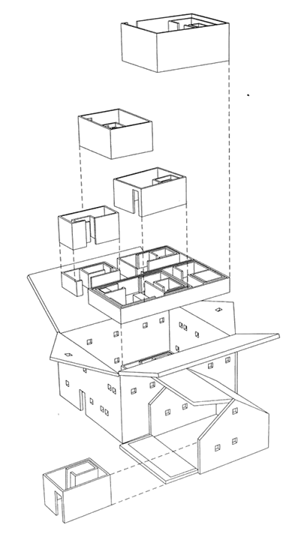
BACKGROUND
Notes:
Goal of project : What is architectural programming? The goal of the project is to help our clients understand how their existing spaces are used, if there is opportunity to optimize spaces for efficiency and be able to project usage patterns into the future.
This project is an exercise into a large university’s science department’s use and facilities. There are two data sets – a Room Inventory (SPACE: lists all rooms in scope of project) & Class inventory (USE: multiple semesters of courses)

Slide 4
DATA: USE
2239 Courses (after dropping events)
9 semesters
36 Subjects
RmType | Tech | Term | Subject | CourseName
DaysMet | ClassDuration | HoursPerWeek | Enrollment
Building | RmID | SeatCapacity
Notes:
Class inventory tells us how the buildings are USED:
Cleanup - had to drop events (anything with a blank value), this could be added back in at a later point as needed
Data Manipulation - Grouped into semesters, calculated avg hours a room was used per week per semester

Slide 5
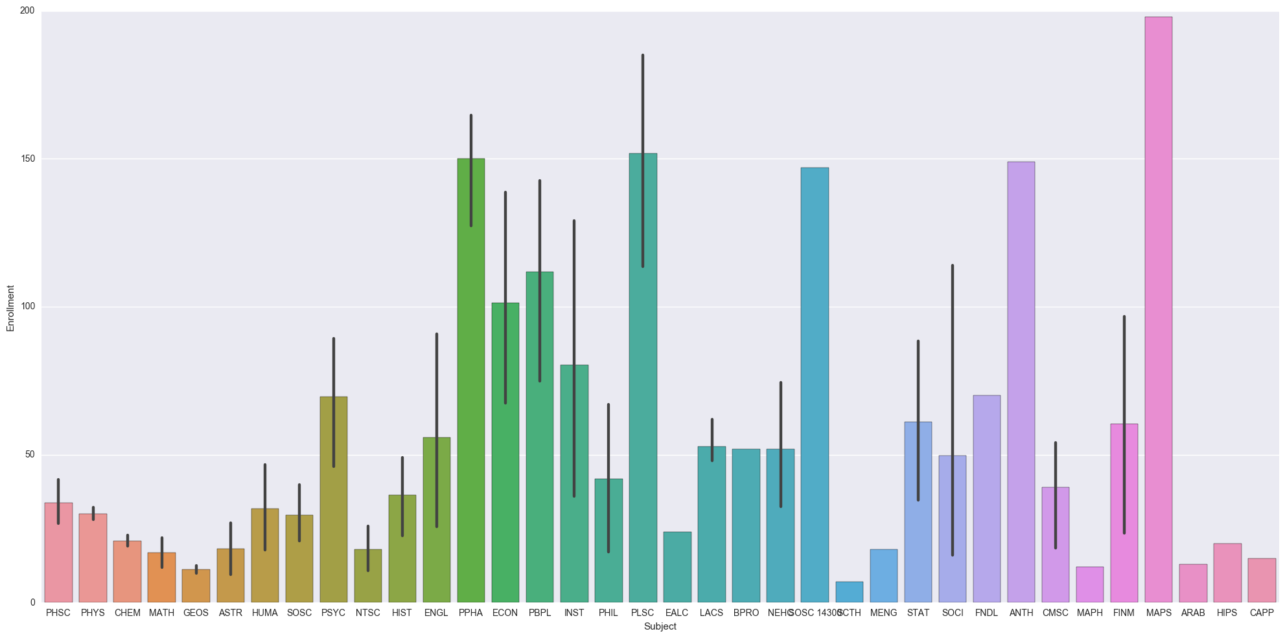
DATA: USE
Mean Class Size (By Dept.)
Notes:
Looking at size of classes for majors- helps identify where particular departments might be better suited for larger facilities

Slide 6
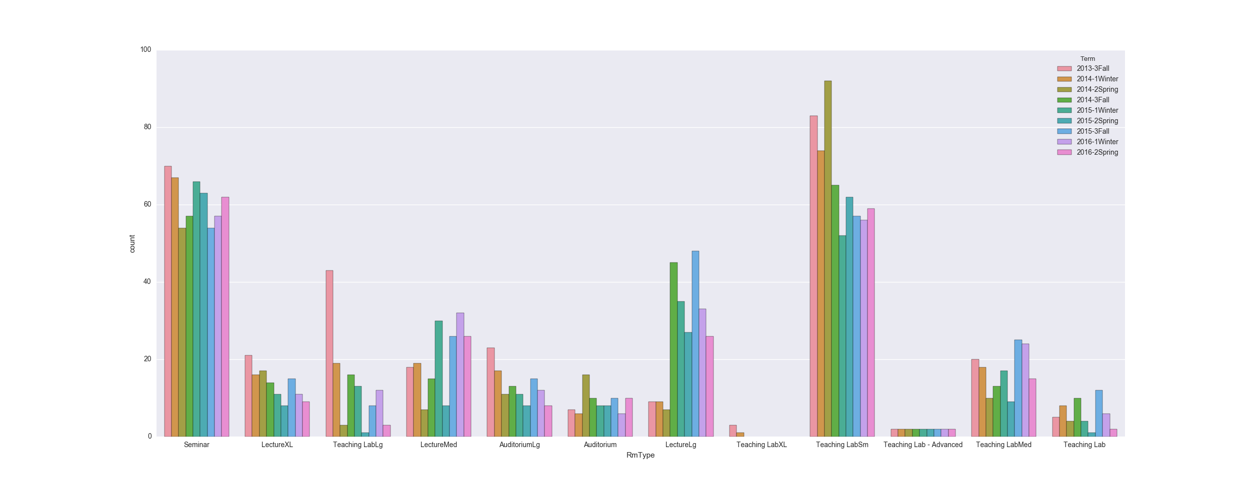
DATA: USE
Count of Room Types Used (By Semester)
Notes:
Illustrates usage patterns over Fall, winter and spring semesters

Slide 7
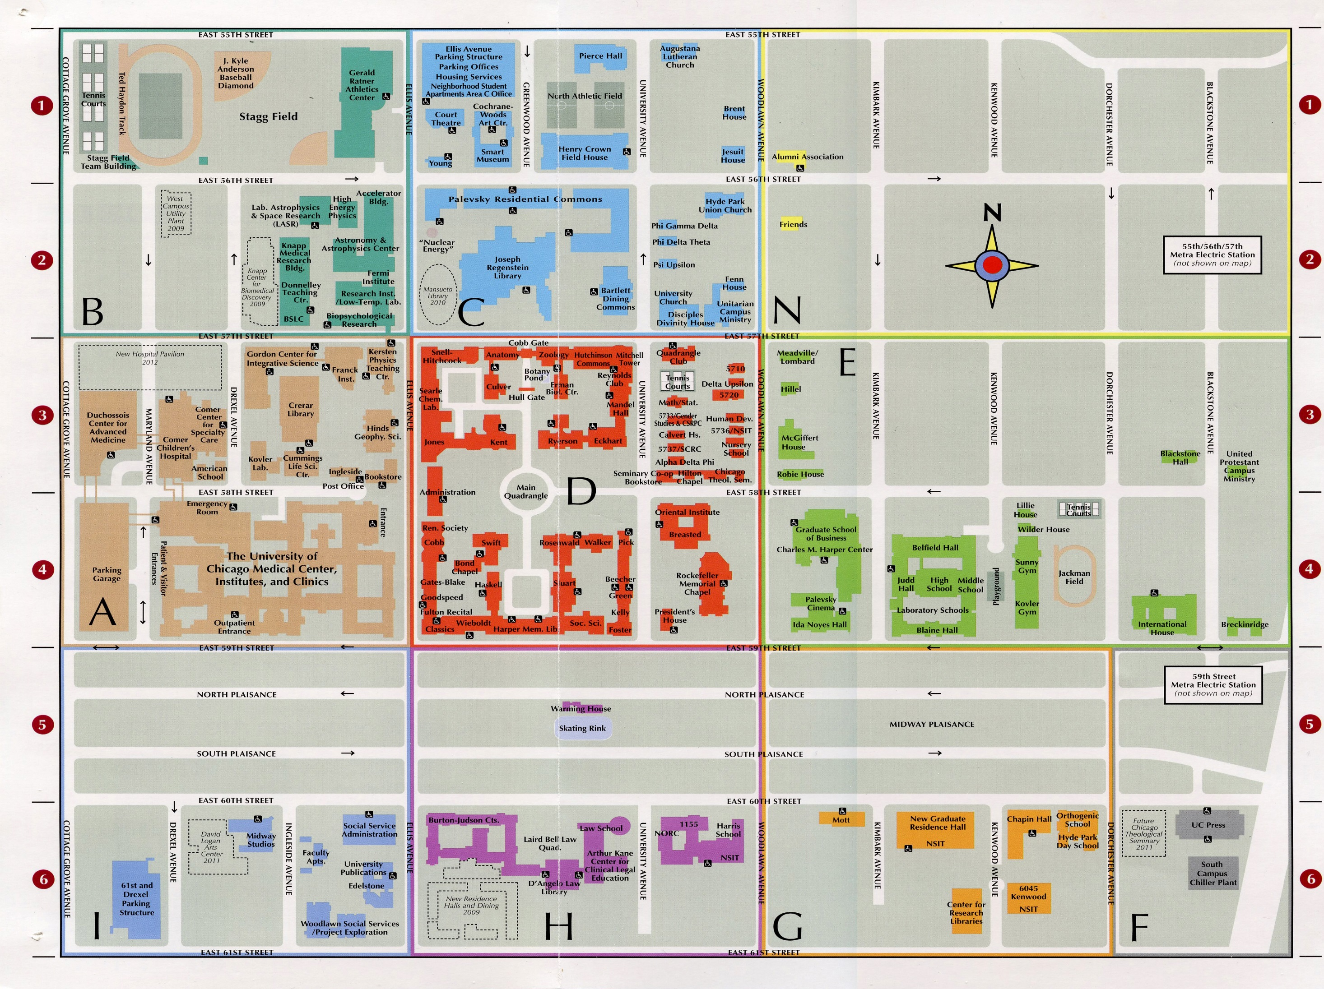
DATA: SPACE
Notes:
Complexity of campus planning – particularly at a large campus scale.

Slide 8
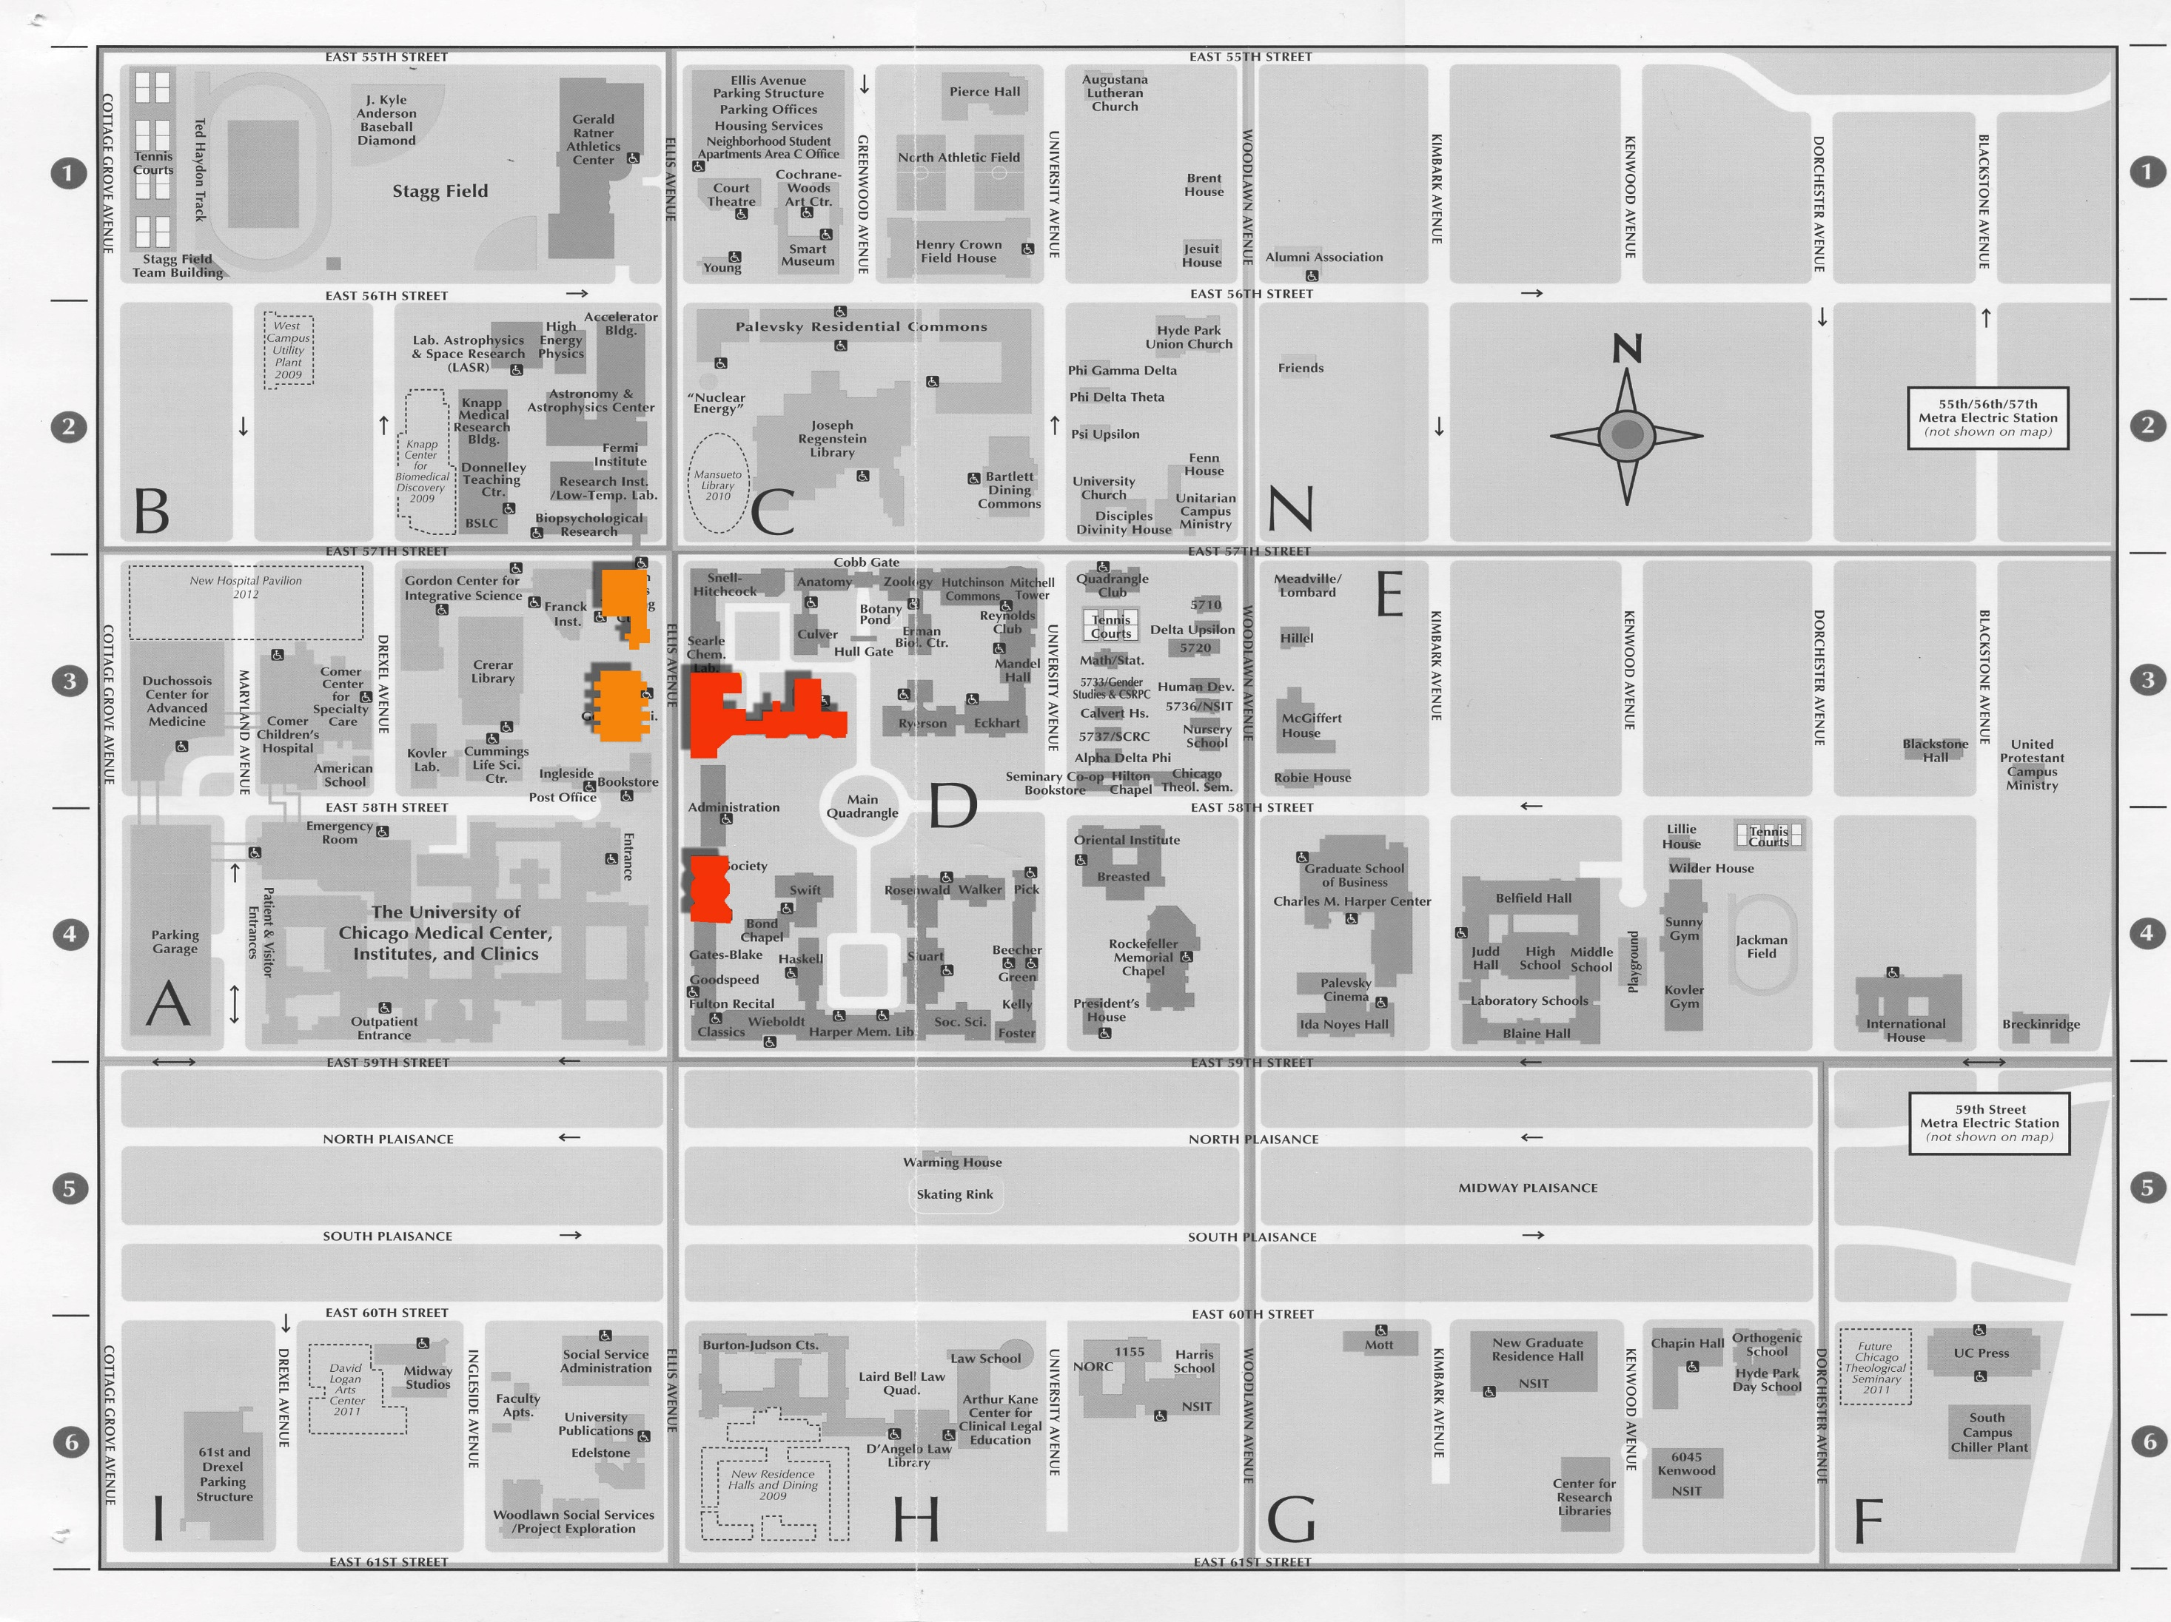
DATA: SPACE
Notes:
The buildings being analyzed. The next data set is the room inventory. It is telling us about the SPACE.

Slide 9
DATA: SPACE
KPTC
HGS
J
K
C

Slide 10
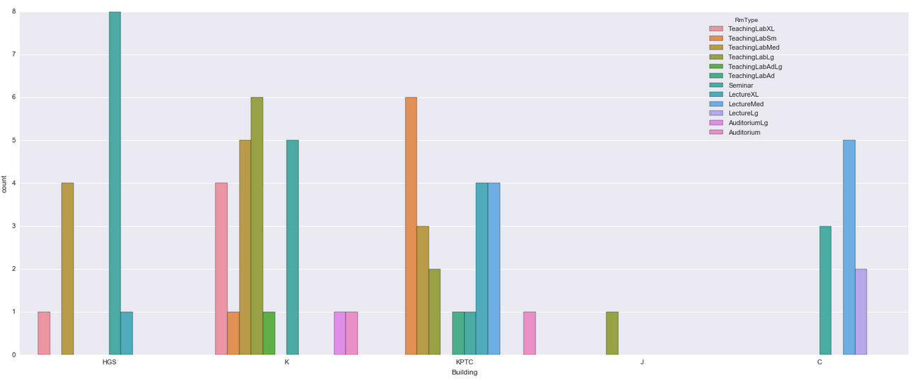
DATA: SPACE
HGS
K
KPTC
J
C
Notes:
Types of rooms found in each building.

Slide 11
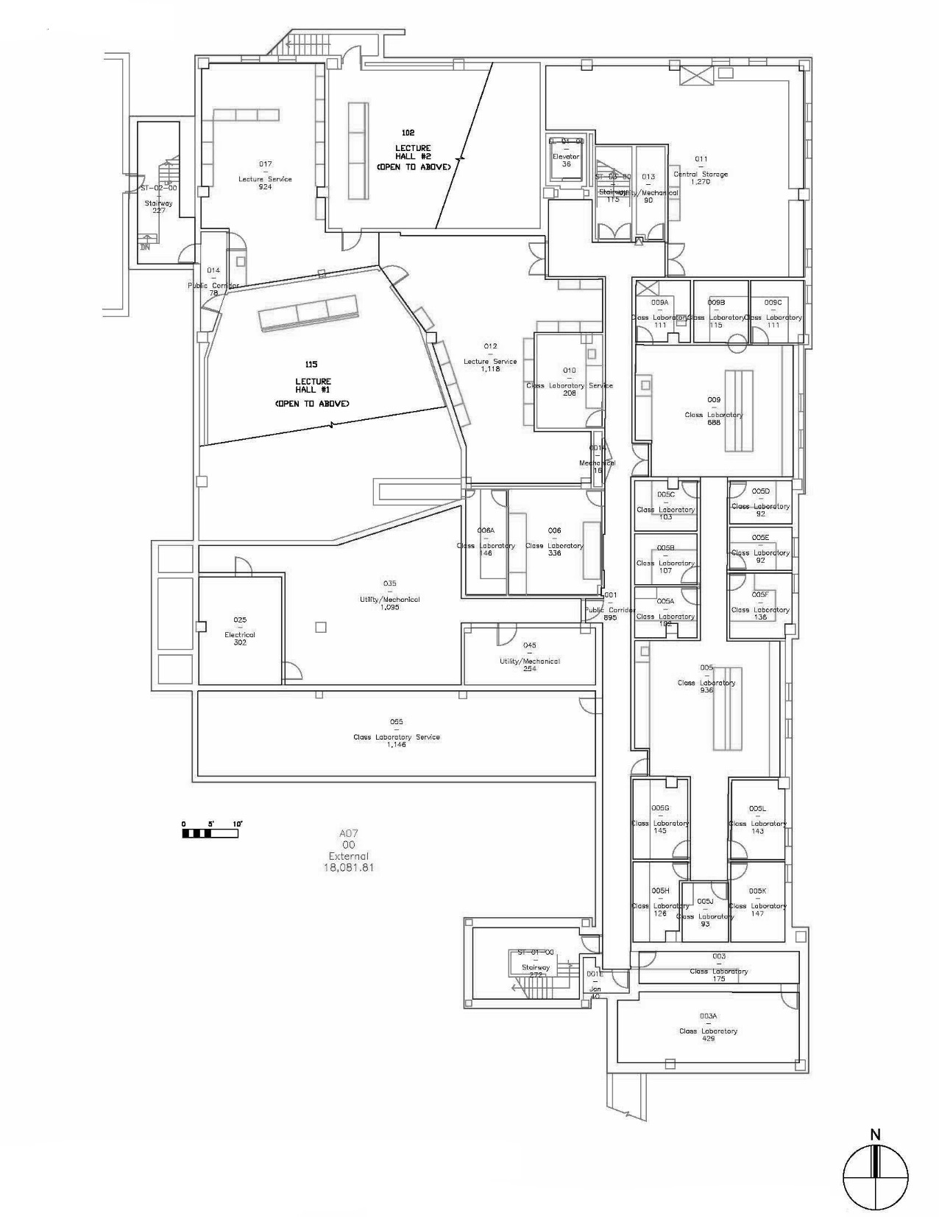
DATA: SPACE
KPTC | KPTC115 | LectureXL

Slide 12
DATA: SPACE
Building | RmID | RmType
Notes:
5 buildings
71 unique room ids
12 room types – this I had to do by grouping similar sized and programmed rooms, could be generalizable for this type of building

Slide 13
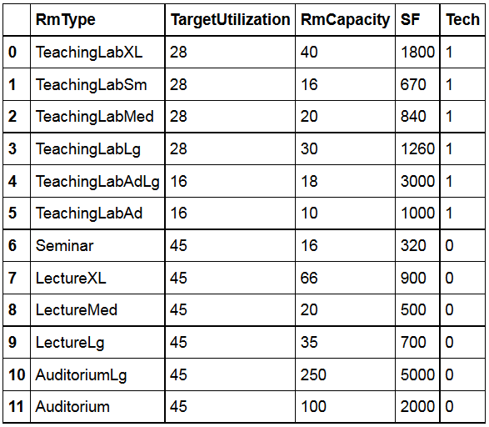
DATA: SPACE
Building | RmID | RmType
Notes:
Room types further define performance requirements
Gives the target utilization which is hours per week the room is intended to be used
Room capacity is how many seats in classroom
Sf lets the building areas be calculated
Tech is whether the space is technical or not

Slide 14
DATA: SPACE
Building | RmID | RmType
Notes:
This is really what we are trying to optimize→ the target utilization rate. In other words this is the number of hours per week that the room is occupied. Anything less than this number means the room isn’t being used to its capacity.

Slide 15
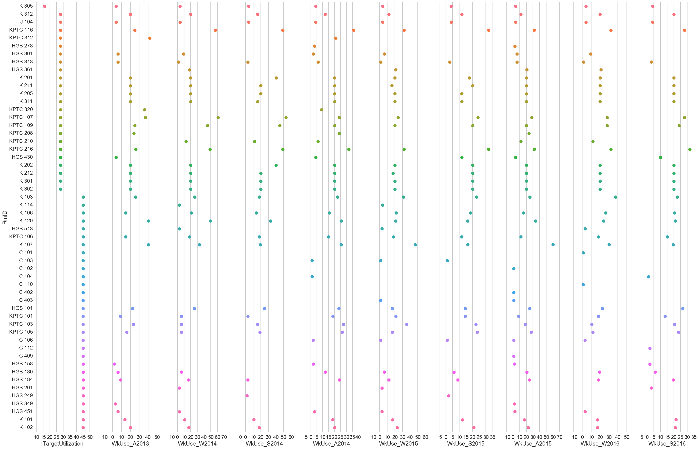
16 HOURS/WK
DATA: SPACE
28 HOURS/WK
45 HOURS/WK
Weekly Room Use In a Perfect World
Notes:
So how can we look at the performance of the facility? Well – lets look at the utilization of the rooms. Heres what each room’s weekly use should be in a perfect world. Now – lets look at ACTUAL use.

Slide 16
DATA: SPACE
Weekly Room Use Compared to Target Utilization (By Semester)
Notes:
Ouch. This is the actual use of these rooms for the past 9 semesters. So what does this tell us? Quite a bit. First there is nearly universal under use, but by looking closer we can ask ourselves WHY are certain rooms not used? Can we make them more useful or pleasant?

Slide 17
MODEL: BINS
ROOMS
1
2
3
4
5
6
CLASSES
A
E
G
B
C
D
F
Notes:
Bin Packing – first algorithm investigated

Slide 18
MODEL: BINS
F
B
D
G
A
E
C
1
2
3
4
5
6
FIRST-FIT
OPTIMIZES FOR LEAST NUMBER OF BINS (ROOMS)
BETTER SUITED FOR NEW CONSTRUCTION
Notes:
To use this method for architectural programing we would need to further complicate the model by using multiple size bins. In new construction this would be fine, as you would want to make the most efficient layout. However, its not really ideal for an existing series of rooms. Which led to…

Slide 19
MODEL: KNAPSACK
ROOMS
CLASSES
A
E
G
B
C
D
F
Notes:
Knapsack algorithm – logical next step if you have defined ‘knapsacks’ – in this case those are the rooms.

Slide 20
MODEL: KNAPSACK
B
F
G
E
D
A
C
FIRST-FIT
OPTIMIZES FOR VALUE OF ITEMS (CLASSES)
COMPLICATED TO SET UP MULTIPLE KNAPSACKS
NOT GENERALIZABLE
MORE IMPORTANTLY : BEYOND MY PYTHON SKILLS
Notes:
Using fixed number/size of existing rooms we can figure out the most value (well fitting classes). Working through this we realize this isn’t something we can generalize – aka ability to use on another project. So it’s a whole lot of work for a one time use. Perhaps not the best use of time. Additionally this really optimizes the USES and not the SPACES. Which leads us to creating our own model…

Slide 21
MODEL
Final Approach:
‘Room Scenario’ is a combination of the 12 room types that ‘fits’ in the square footage of the existing buildings
Exhaustive list was way too many (something like 71! possible arrangements ) so I had to get creative
Figure out the highest hours used in a semester of a given room type (take top occurrence over 9 semesters) → this is the base requirement
Given the amount of space ‘left over’ I can figure out the growth potential (say 10% over 6 years)
Compare the base requirements of rooms to what currently exists. Anything superfluous was converted to ‘flex’ area I could come up with room combos for this flexible space. .. This was about 3k+ combos to review.
Calculate cost of these new spaces. The cost is based on conversion between technical and non-technical space.
Make suggestions to the client!

Slide 22
MODEL
Scenario X (Future)
20 rooms
7 Non-Technical
13 Technical
23 to 20 rms : 3 Wall Removals →
@ $5k = $15k
3 Technical Rms Added →
@ $20k = $60k
Cost of Scenario X = $75k
Existing
23 rooms
13 Non-Technical
10 Technical
Required(Now)
11 rooms (14 Free)
7 Non-Technical (5 Free)
4 Technical (6 Free)

Slide 23
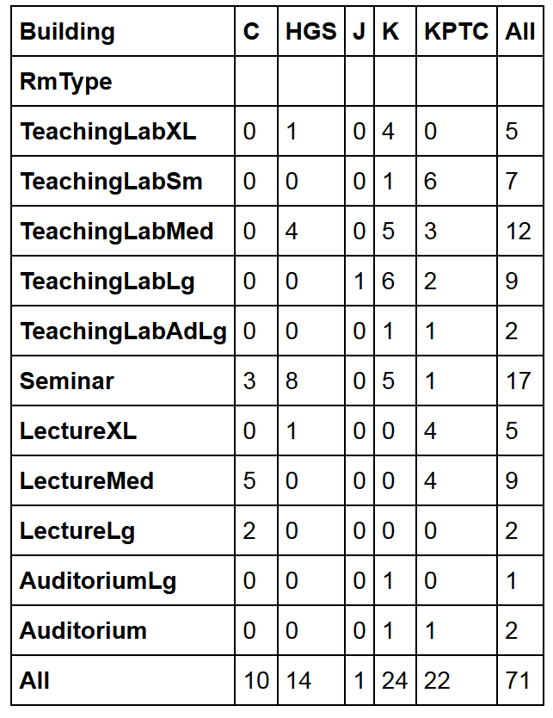
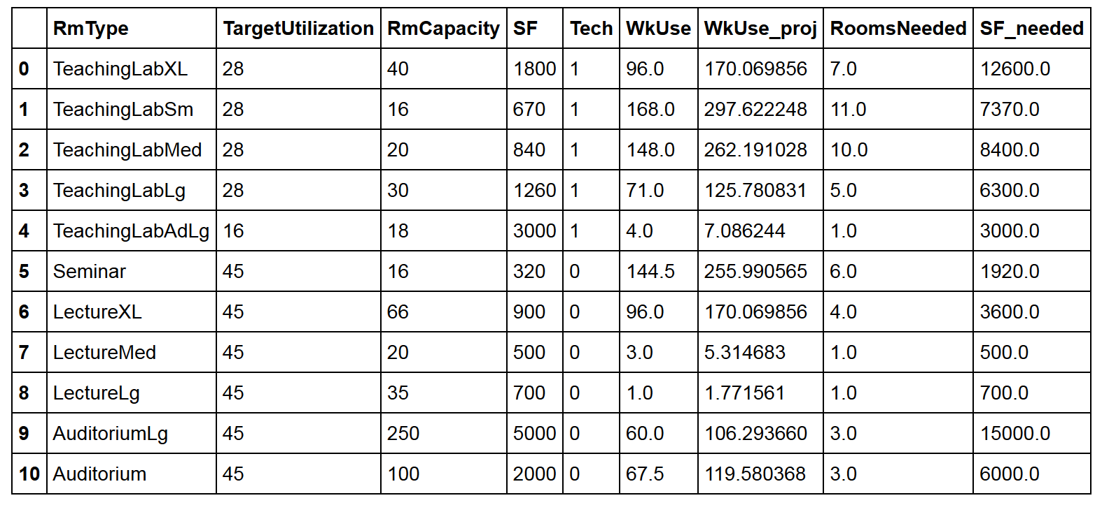
RESULTS
What we have in the buildings…..

Slide 24
RESULTS
What we need in the buildings…..

Slide 25
RESULTS
We only need 51 rooms total to handle the extreme growth… (but there’s going to be a shortage of 2,470 SF)

Slide 26
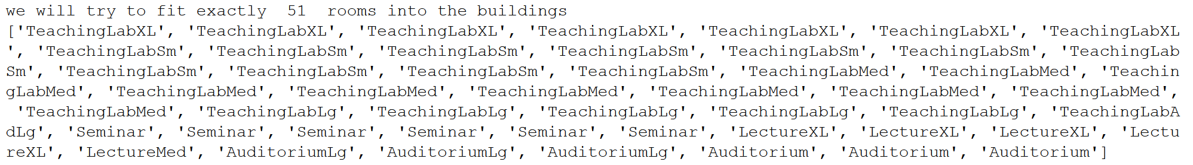
RESULTS

Slide 27
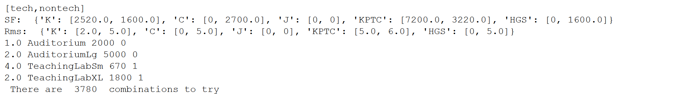
RESULTS

Slide 28
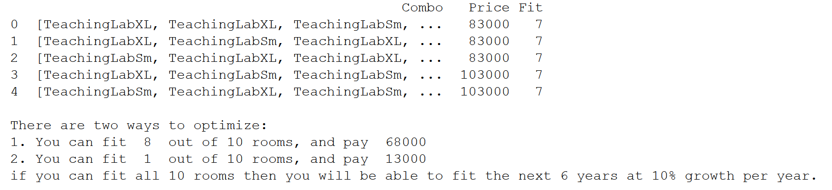
RESULTS

Slide 29
Scoring metrics - Percentage of Seats Filled - Adjacency of classes per department Scope of Model - Extending to additional buildings - Specific growth by department Visualization - Dynamic graphics that update on floor plans - Integration with BIM (3d database modeling) software
NEXT STEPS

